Slide 1
Jim Bob the Dragon Goes to the Museum
Psych 101 Learning project by Hannah Riley

Slide 2
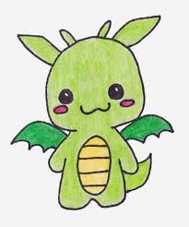
This is Jim Bob the dragon.
Jim Bobs on his way to the Museum for the very first time!

Slide 3
Jim Bob has to go to the museum to study pictures and determine what kind of psychology they are for his baby psychology class, because he is a baby.
He walks into the museum and sees a lot of pretty pictures and sculptures.
These pictures make him think.

Slide 4
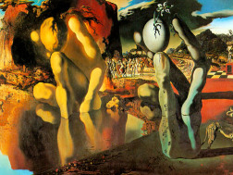
Picture Number 1
This picture looked very trippy to Jim Bob. At first, he though it was a comparison of two pictures, but really it was one picture. It also kind of gave him a head ache.

Slide 5
This picture would be an example of Structuralism because with all of the sensations that come into this picture, a Structuralist would be the one to analyze why this picture makes people feel the way they feel while looking at it. Like how Jim Bob felt trippy.

Slide 6
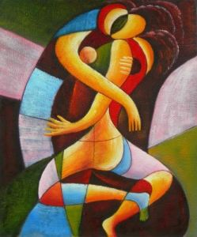
Picture number 2
Jim Bob thought of a big warm hug when he saw this picture.

Slide 7
This picture would be an example of behaviorism due to the overt behavior happening here, but also possibly and example of Structuralism due to all of the stimulating colors and shapes that a Structuralist would want to analyze.

Slide 8
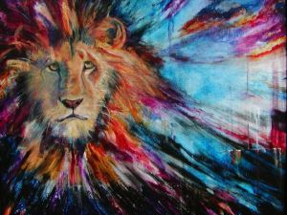
Picture number 3
When Jim Bob saw this, he shuddered. It reminded him of the fear he has of the infinite nothingness of space and the universe.

Slide 9
He also has a healthy fear of lions.
He’s a baby.
Leave him alone.
His reaction was overt and was an example of functionalism because a fear of lions is healthy and is instinctual. His fear of the nothingness is probably a psychological problem that functionalists are welcome to figure out.

Slide 10
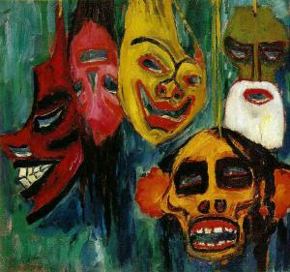
Picture number 4
This made Jim Bob think of masks, like the ones at Halloween or tribal masks.

Slide 11
This thought could be examined by essentially all of the form of psychology.
Humanism and behaviorism because of why the masks were made.
Gestalt because he’s looking at and thinking about all of the masks.
Structuralism because of how the masks made others think, feel, react, etc.
Functionalism because of what the masks were made to do. Whether it be to scare others, tell what group you are in, honor others, and many other possible reasons.

Slide 12
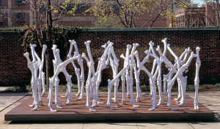
Picture number 5
This reminded Jim Bob of dinner.

Slide 13
Kidding. It reminded him of bedtime stories his mommy told him of how even though people may essentially be made the same, everyone is different. Whether it be how they act, move, bend, etc.
This is an example of a mix of humanism and behaviorism, because he thought about and focused on people while it is also behaviorism because he thought about how everything acted and behaved.

Slide 14
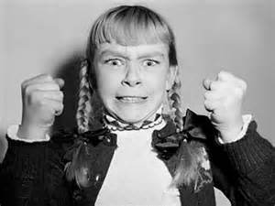
picture number 6
Seeing this picture really made Jim Bob question everything about this picture. Who is this girl? Why is she so angry? The longer he looked, the more he worried about her.

Slide 15
His reaction would be an example of humanism, because he focused solely on wanting to help the girl in the picture and make her happy.
The picture itself, however, would most likely be studied by behaviorists because of how overt her actions are.

Slide 16
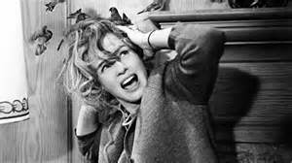
picture number 7
Due to Jim Bob being a baby, his mommy won’t let him watch the move The Birds, which is where this scene is from, so he doesn’t know what originally happens here. He was concerned that the woman was in danger and wanted to help.

Slide 17
This reaction would be that of humanism because he was concerned for human life and wanted to help her with what her problem was.
She was being attacked by birds Jim Bob, that was her problem.

Slide 18
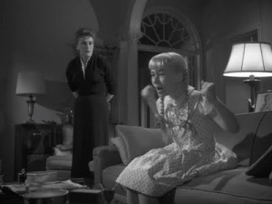
Picture number 8
Jim Bob noticed that this was the same little girl from picture 6 and thought about how this is one angry little girl and decided to look at the big picture as a whole. Maybe she was an angry child. Or maybe she was a spoiled brat.

Slide 19
This essential thought process is an example of Gestalt psychology, as he decided to only look at the whole story, not just the little pieces that go into her story.
This would still be focused on by behaviorists though because of how overt her actions continue to be.

Slide 20
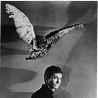
Picture number 9
Due to lack of definition of the picture, Jim Bob can’t tell what kind of bird that is that is about to, what looks like, attack the man, but Jim Bob is worried about this man and this bird. Wondering if the man will be okay and wondering what this man did to provoke this animal.

Slide 21
Again, another example of humanism at work, but behaviorism would come to play as for how the man will react and why the bird decided to attack.

Slide 22
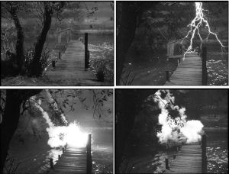
Picture number 10
At first, Jim Bob wasn’t really sure how to feel about this picture. Jim Bob is concerned for whomever could have been on that dock and now is concerned that may start a fire that could spread.

Slide 23
These pictures make Jim Bob concerned a lot.
His reaction would be an example of Functionalism because his mind went to wanting to stop the fire, which is, loosely termed, instinctive.

Slide 24
Finally, it was time for Jim Bob to go home to his cave and think about all the stimulating images he saw.
He thought about hid overt reactions to some pictures and his covert reactions to all of them. He also thought about how of all the types of psychology, the ones used most were Humanism and Behaviorism. Those two dealt the most with what exactly was going on and why. Where as gestalt thought about the whole idea and structuralism look at how what the stimuli did to you.
Today was an exciting day for Jim Bob. He felt, saw, thought, and now it’s time to go.

Slide 25
“Goodbye”
Say goodbye Jim Bob

